Slide 1
Process Scheduling
B.Ramamurthy
Page <number>

Slide 2
Introduction
An important aspect of multiprogramming is scheduling. The resources that are scheduled are IO and processors.
The goal is to achieve
  High processor utilization
  High throughput
    number of processes completed per unit time
  Low response time
    time elapse from the submission of a request to the beginning of the response
Page <number>

Slide 3
Topics for discussion
Motivation
Types of scheduling
Short-term scheduling
Various scheduling criteria
Various algorithms
  Priority queues
  First-come, first-served
  Round-robin
  Shortest process first
  Shortest remaining time and others
Page <number>

Slide 4
The CPU-I/O Cycle
We observe that processes require alternate use of processor and I/O in a repetitive fashion
Each cycle consist of a CPU burst (typically of 5 ms) followed by a (usually longer) I/O burst
A process terminates on a CPU burst
CPU-bound processes have longer CPU bursts than I/O-bound processes
Page <number>

Slide 5

CPU/IO Bursts
Bursts of CPU usage alternate with periods of I/O wait
  a CPU-bound process
  an I/O bound process
Page <number>

Slide 6
Motivation
Consider these programs with processing-component and IO-component indicated by upper-case and lower-case letters respectively.
A1 a1 A2 a2 A3
0 30 50 80 120 130 ===> JOB A
B1 b1 B2
0 20 40 60 ====> JOB B
C1 c1 C2 c2 C3 c3 C4 c4 C5
0 10 20 60 80 100 110 130 140 150 =>JOB C
Page <number>

Slide 7
Motivation
The starting and ending time of each component are indicated beneath the symbolic references (A1, b1 etc.)
Now lets consider three different ways for scheduling: no overlap, round-robin, simple overlap.
Compare utilization U =
time CPU busy / total run time
Page <number>

Slide 8
Scheduling Criteria
CPU utilization – keep the CPU as busy as possible
Throughput – # of processes that complete their execution per time unit
Turnaround time – amount of time to execute a particular process
Waiting time – amount of time a process has been waiting in the ready queue and blocked queue
Response time – amount of time it takes from when a request was submitted until the first response is produced, not output (for time-sharing environment)
Page <number>

Slide 9
Optimization Criteria
Max CPU utilization
Max throughput
Min turnaround time
Min waiting time
Min response time
Page <number>

Slide 10
Types of scheduling
Long-term : To add to the pool of processes to be executed.
Medium-term : To add to the number of processes that are in the main memory.
Short-term : Which of the available processes will be executed by a processor?
IO scheduling: To decide which process’s pending IO request shall be handled by an available IO device.
Page <number>

Slide 11
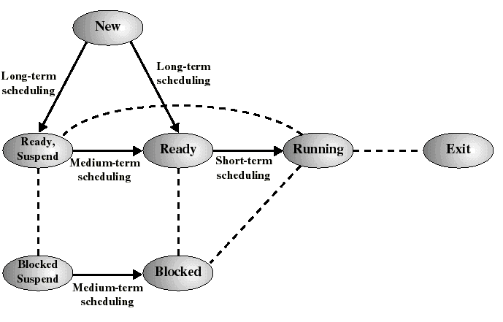
Classification of Scheduling Activity
Long-term: which process to admit
Medium-term: which process to swap in or out
Short-term: which ready process to execute next
Page <number>

Slide 12
First-Come, First-Served (FCFS) Scheduling
Process Burst Time
P₁ 24
P₂ 3
P₃ 3
Suppose that the processes arrive in the order: P₁ , P₂ , P₃
The Gantt Chart for the schedule is:
Waiting time for P₁ = 0; P₂ = 24; P₃ = 27
Average waiting time: (0 + 24 + 27)/3 = 17
P₁
P₂
P₃
0
24
27
30
Page <number>

Slide 13
FCFS Scheduling (Cont.)
Suppose that the processes arrive in the order
P₂ , P₃ , P₁ .
The Gantt chart for the schedule is:
Waiting time for P₁ = 6; P₂ = 0; P₃ = 3
Average waiting time: (6 + 0 + 3)/3 = 3
Much better than previous case.
Convoy effect short process behind long process
P₂
P₃
P₁
0
3
6
30
Page <number>

Slide 14
Shortest-Job-First (SJR) Scheduling
Associate with each process the length of its next CPU burst. Use these lengths to schedule the process with the shortest time.
Two schemes:
  nonpreemptive – once CPU given to the process it cannot be preempted until completes its CPU burst.
  preemptive – if a new process arrives with CPU burst length less than remaining time of current executing process, preempt. This scheme is know as the
  Shortest-Remaining-Time-First (SRTF).
SJF is optimal – gives minimum average waiting time for a given set of processes.
Page <number>

Slide 15
Example of Non-Preemptive SJF
Process Arrival Time Burst Time
P₁ 0.0 7
P₂ 2.0 4
P₃ 4.0 1
P₄ 5.0 4
Average waiting time = (0 + 6 + 3 + 7)/4 = 4
P₁
P₃
P₂
P₄
0
3
7
8
12
16
Page <number>

Slide 16
Example of Preemptive SJF
Process Arrival Time Burst Time
P₁ 0.0 7
P₂ 2.0 4
P₃ 4.0 1
P₄ 5.0 4
Average waiting time = (9 + 1 + 0 +2)/4 = 3
P₁
P₂
P₃
P₂
P₄
P₁
0
2
4
5
7
11
16
Page <number>

Slide 17
Shortest job first: critique
Possibility of starvation for longer processes as long as there is a steady supply of shorter processes
Lack of preemption is not suited in a time sharing environment
  CPU bound process gets lower priority (as it should) but a process doing no I/O could still monopolize the CPU if he is the first one to enter the system
SJF implicitly incorporates priorities: shortest jobs are given preferences
The next (preemptive) algorithm penalizes directly longer jobs
Page <number>

Slide 18
Priority Scheduling
A priority number (integer) is associated with each process
The CPU is allocated to the process with the highest priority (smallest integer ≡ highest priority).
  Preemptive
  nonpreemptive
SJF is a priority scheduling where priority is the predicted next CPU burst time.
Problem ≡ Starvation – low priority processes may never execute.
Solution ≡ Aging – as time progresses increase the priority of the process.
Page <number>

Slide 19
Round Robin (RR)
Each process gets a small unit of CPU time (time quantum), usually 10-100 milliseconds. After this time has elapsed, the process is preempted and added to the end of the ready queue.
If there are n processes in the ready queue and the time quantum is q, then each process gets 1/n of the CPU time in chunks of at most q time units at once. No process waits more than (n-1)q time units.
Performance
  q large ⇒ FIFO
  q small ⇒ q must be large with respect to context switch, otherwise overhead is too high.
Page <number>

Slide 20
Example of RR with Time Quantum = 20
Process Burst Time
P₁ 53
P₂ 17
P₃ 68
P₄ 24
The Gantt chart is:
Typically, higher average turnaround than SJF, but better response.
P₁
P₂
P₃
P₄
P₁
P₃
P₄
P₁
P₃
P₃
0
20
37
57
77
97
117
121
134
154
162
Page <number>

Slide 21
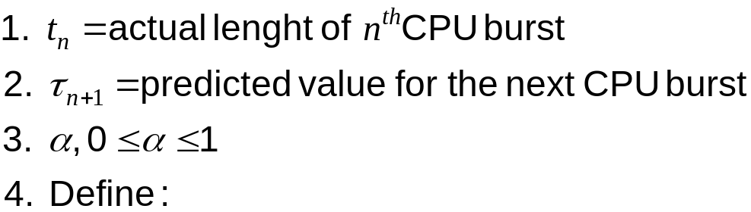

Determining Length of Next CPU Burst
Can only estimate the length.
Can be done by using the length of previous CPU bursts, using exponential averaging.
Page <number>

Slide 22
Examples of Exponential Averaging
α =0
  τ_{n+1} = τ_{n}
  Recent history does not count.
α =1
  τ_{n+1} = t_{n}
  Only the actual last CPU burst counts.
If we expand the formula, we get:
    τ_{n+1} = α t_{n}+(1 - α) α t _{n -1} + …
    +(1 - α ) ^{j} α t _{n -j} + …
    +(1 - α )^{n+1} τ₁
Since both α and (1 - α) are less than or equal to 1, each successive term has less weight than its predecessor.
Page <number>

Slide 23
More on Exponential Averaging
S[n+1] next burst, S[n] current burst (predicted), T[n] actual,
  S[n+1] = α T[n] + (1-α) S[n] ; 0 < α < 1
  more weight is put on recent instances whenever α > 1/n
By expanding this eqn, we see that weights of past instances are decreasing exponentially
  S[n+1] = αT[n] + (1-α)αT[n-1] + ... (1-α)^{i}αT[n-i] +
  ... + (1-α)^{n}S[1]
  predicted value of 1st instance S[1] is not calculated; usually set to 0 to give priority to new processes
Page <number>

Slide 24
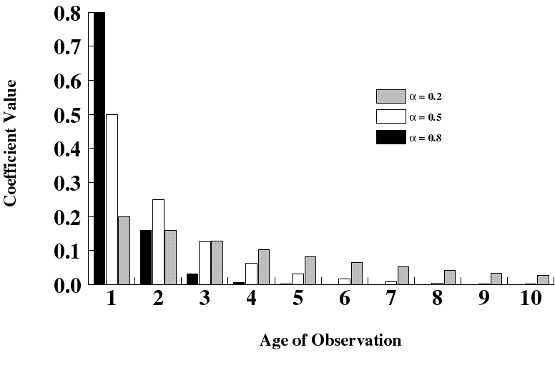
Exponentially Decreasing Coefficients
Page <number>

Slide 25
Example
Assume the following burst-time pattern for a process: 6, 4, 6, 4, 13,13, 13 and assume the initial guess is 10. Predict the next burst-time, α=0.8. Ans: use the equation in bullet 1 of slide 23.
Sn | 10 | 6.8 | 4.56 | 5.71 | 4.34 | 11.27 | 12.49
Tn | 6 | 4 | 6 | 4 | 13 | 13 | 13
Sn+1 | 6.8 | 4.56 | 5.71 | 4.34 | 11.27 | 12.49 | 12.89
Page <number>

Slide 26
Example
Assume the following burst-time pattern for a process: 6, 4, 6, 4, 13,13, 13 and assume the initial guess is 10. Predict the next burst-time, α=0.2 and compare with ɑ=0.8; try it for ɑ=0.5, 1.0
Sn |  | 10 | 6.8 | 4.56 | 5.71 | 4.34 | 11.27 | 12.49
Tn |  | 6 | 4 | 6 | 4 | 13 | 13 | 13
Sn+1 | ɑ=0.8 | 6.8 | 4.56 | 5.71 | 4.34 | 11.27 | 12.49 | 12.89
Sn+1 | ɑ=0.2 | 8.96 | 7.808 | 7.206 | 6.405 | 7.204 | 7.843 | 8.354
Page <number>

Slide 27
Summary
Scheduling is important for improving the system performance.
Methods of prediction play an important role in Operating system and network functions.
Simulation is a way of experimentally evaluating the performance of a technique.
Next class we will examine queuing theory that allows for modeling of the scheduling disciplines.
Page <number>

